Slide 1
WEBSITE MAKERS
EXTRAORDINAIR

Slide 2
Meet the Team
Greg VanKampen
Vaughn Rowse
Project Manager
Back End Developer
Spokesperson
Front End Developer
File Manager
Visual Designer

Slide 3

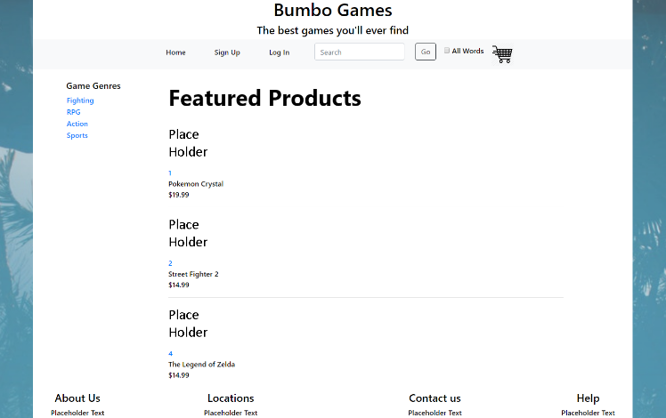
BUMBO GAMES
Bumbo Games is an electronic entertainment company focused on the sale of DRM-free PC games. Through this new website, Bumbo Games customers will be able to browse, purchase, and enjoy the large library Bumbo Games has to offer.

Slide 4
WEBSITE DEMO

Slide 5
THANKS!
We appreciate your interest and attendance.
Web Makers Extraordinair

